Slide 1





SMART INDIA HACKATHON 2026
  Problem Statement ID –SIH26202​
  Problem Statement Title- E20 Shield Smart Dosing System
  Theme- Smart Automation​
  PS Category- Hardware
  Team ID- 54​
  Team Name- Syntax Syndicate​

Slide 2

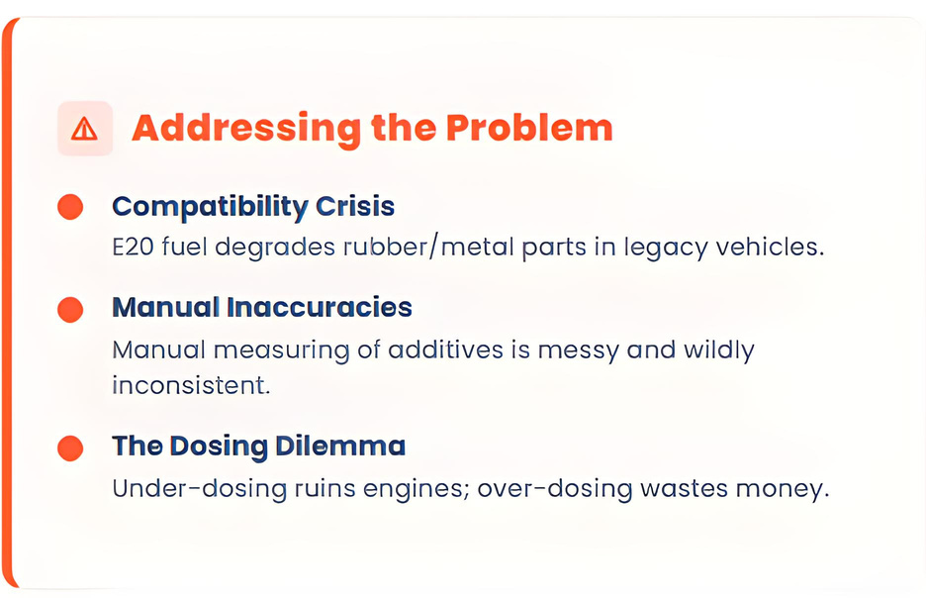
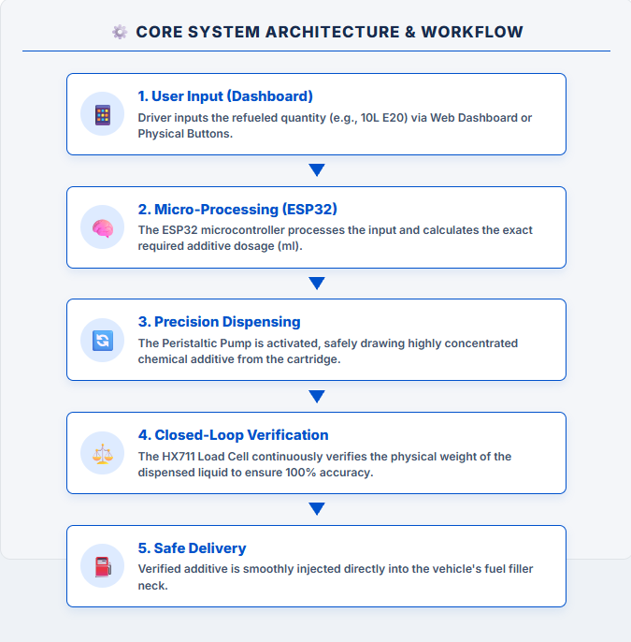

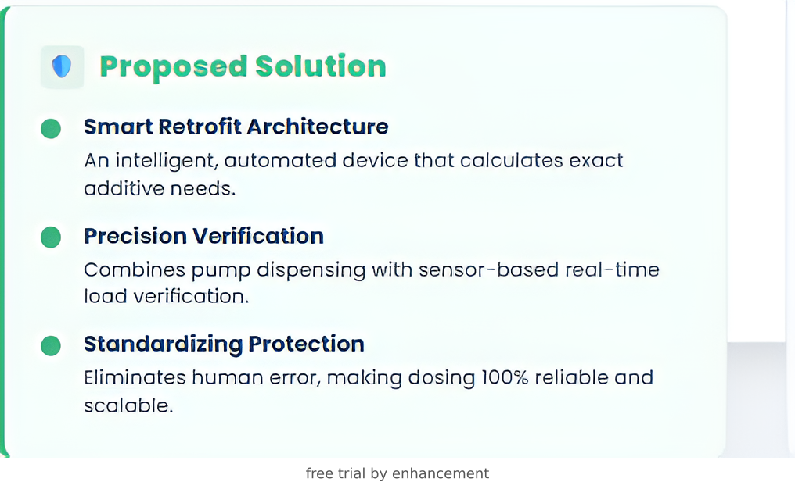
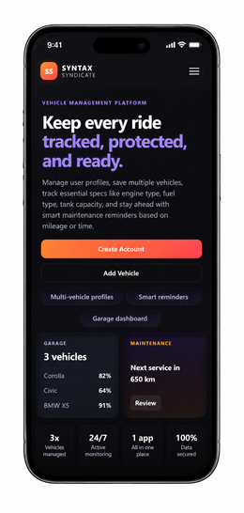
E20 SHIELD: SMART DOSING SYSTEM​
“Bridging the Gap Between E20 Adoption and Legacy Vehicles.”​
@Syntax Syndicate
2

Slide 3
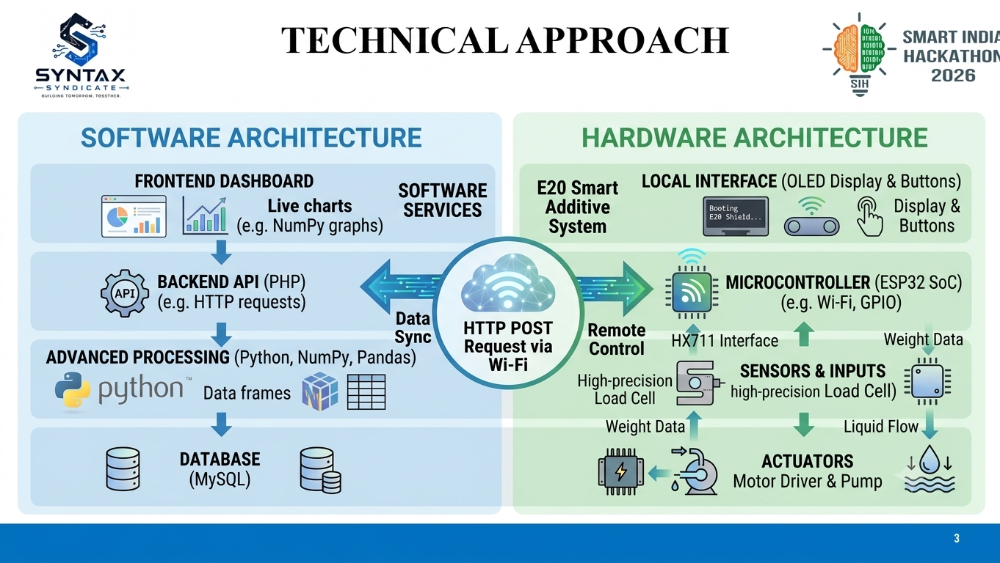
TECHNICAL APPROACH
@Syntax Syndicate
3

Slide 4
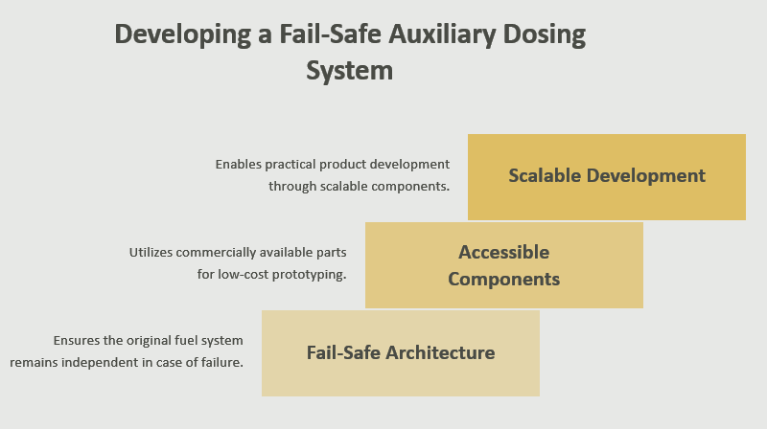
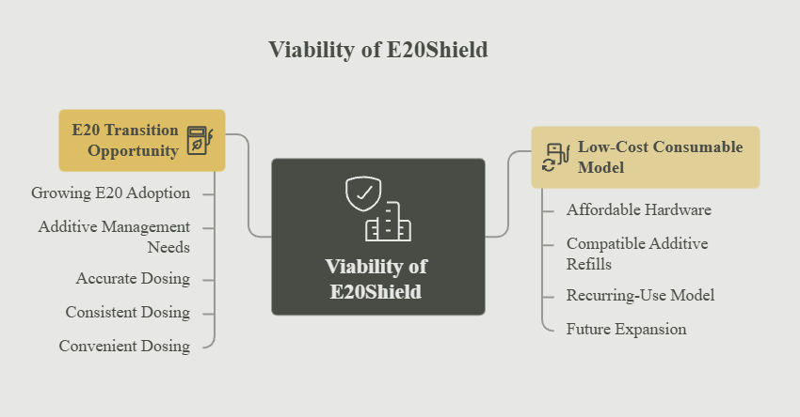
FEASIBILITY AND VIABILITY
FEASIBILITY
VIABILITY
FUTURE
SCOPE
  AI & IoT Smart Dosing
  Large-Scale Deployment
Integrate sensors & AI to monitor fuel consumption in real time, enabling adaptive dosing and automated mobile alerts.
Scale the architecture to support commercial fleets, public buses, and adapt for varying future ethanol-fuel blends.
@Syntax Syndicate
4

Slide 5
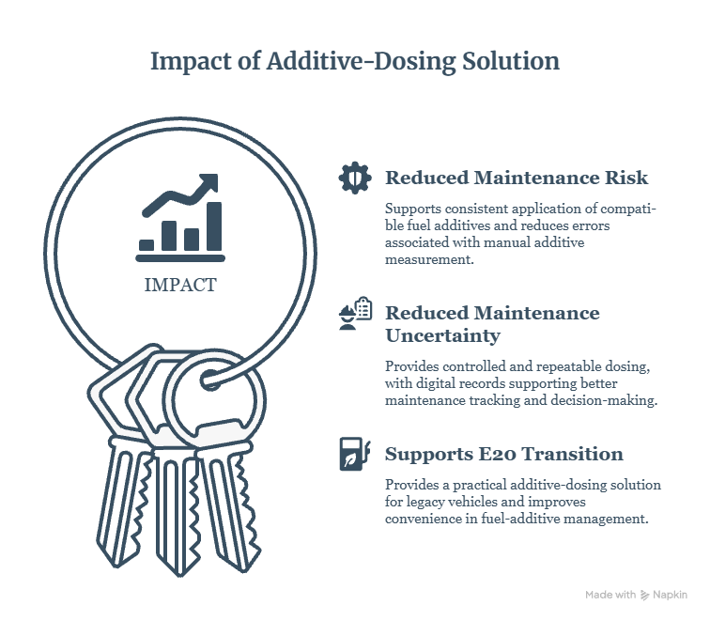
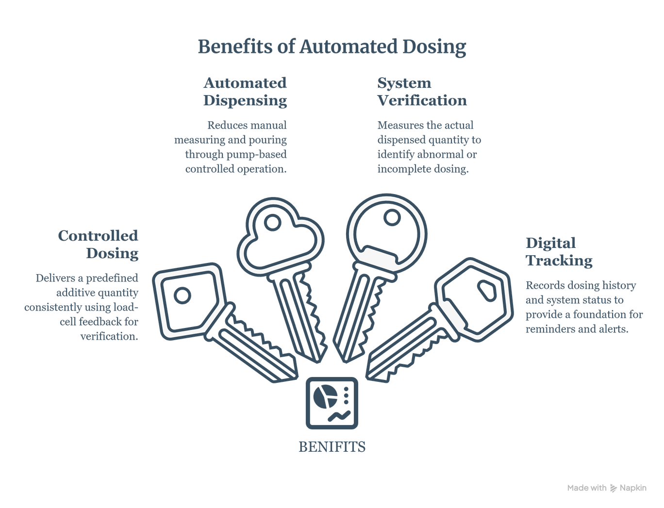
IMPACT AND BENEFITS
Impacts of Additive-Dosing Solutions
Benefits of automated dosing
@Syntax Syndicate
5

Slide 6
RESEARCH AND REFERENCES
Research
  Government Policy & Mandate: NITI Aayog Expert Committee Report on "Roadmap for Ethanol Blending in India 2020-25" & MoPNG Guidelines. MoPNG
  Automotive Standards & Impact: Automotive Research Association of India (ARAI) guidelines on E20 material compatibility. ARAI
  Scientific Validation: IEEE Xplore & Google Scholar research papers on "Corrosion behavior of automotive fuel system materials in ethanol-blended gasoline".
References
  Microcontroller & IoT Architecture: Espressif Systems Official ESP32 Technical Documentation and Data-Sheets.
  Sensor Calibration & Integration: SparkFun Electronics hookup guide for HX711 Load Cell Amplifier (used for precise additive dosing).
@Syntax Syndicate
6

